Slide 1
Statistical Analysis of Craft Beers and Breweries in the United States
Willis A. Jones
wajones@smu.edu
Kristin Henderson
hendersonk@smu.edu
Notes:
Hi…….…once again My name is Willis Jones and along with my partner Kristin Henderson we are excited to share part 2 of our statistical analysis of craft beers and breweries
This presentation will be a continuation of our last video where we used beer and brewery data to provide insights into the craft beer industry

Slide 2
From previous presentation:
How many breweries are present in each state?
How much missing data was in the dataset provided?
What is the median alcohol content and international bitterness units for beers in each state?
Which state has the beer with the maximum alcohol by volume and highest international bitterness units?
What are descriptive statistics for craft beer alcohol by volume (ABV)?
What is the relationship between beer bitterness and alcoholic content?
Notes:
As a review, in our first presentation we answered the following questions for you all. The slide deck addressing these questions has been provided to you.
In this presentation, we are going to expand our answers for few of these previously asked questions and answer a couple of new questions related to the data you provided.

Slide 3

Client Question: How much missing data were in the dataset provided?
Notes:
In our previous presentation, we were asked to talk about missing data.

Slide 4
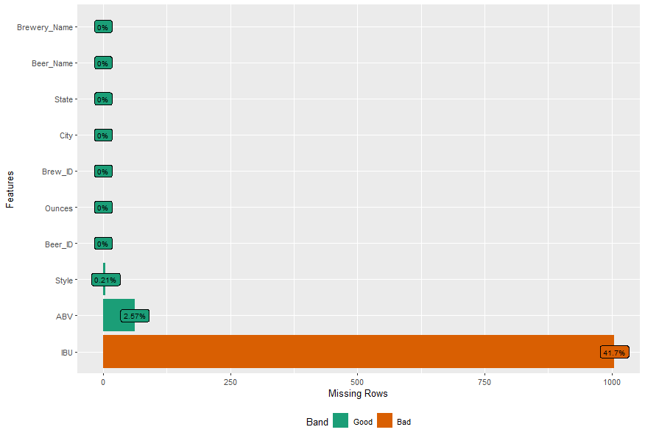
Notes:
And we noted that most of the variable in the dataset were without missing data. However, 41% of the data for International bitterness units was missing.
In our previous presentation, we noted that we dropped these missing observations…
However, we attempted to further explore the mechanism that caused this missing and determined that we would imput missing IBU values with the median value of IBU based on the style of the beer. We describe this process in our full report.

Slide 5
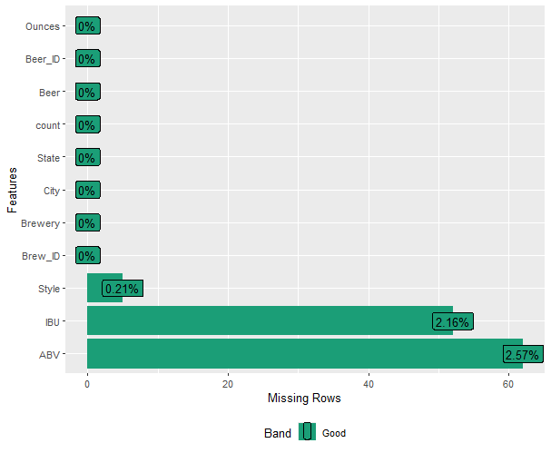
Notes:
After this imputation process, we were left with only 2.16% missing data on the IBU variable. These were for beer styles that did not have any values for IBU in the original dataset we were provided.
We assumed all the remaining missing data were missing completely at random and deleted the observations.

Slide 6
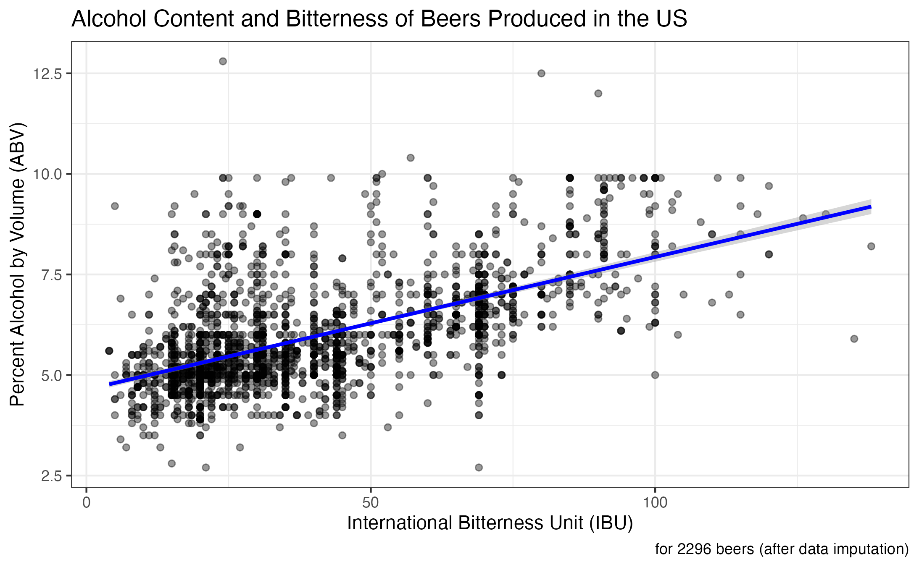
Correlation Coefficient = .59
95% Confidence Interval = .56, .62
N = 2296
Notes:
With this imputated data, we reran our analysis of the correlation between alcohol per volume and IBU.
We found the correlation coefficient was 0.59 with a 95% confidence interval of 0.56 to 0.62.
This shows a Strong correlation between Alcohol and Bitterness. (the finding was not very different than the analysis we ran before which dropped the missing data)

Slide 7
Client Question: Can the general style (IPA vs. Ale) be predicted based on a beer’s ABV and IBU values?
Notes:
Let's delve into our new analysis. Our first question explores whether we can predict a beer's general style—IPA or Ale—based on its ABV and IBU values.

Slide 8
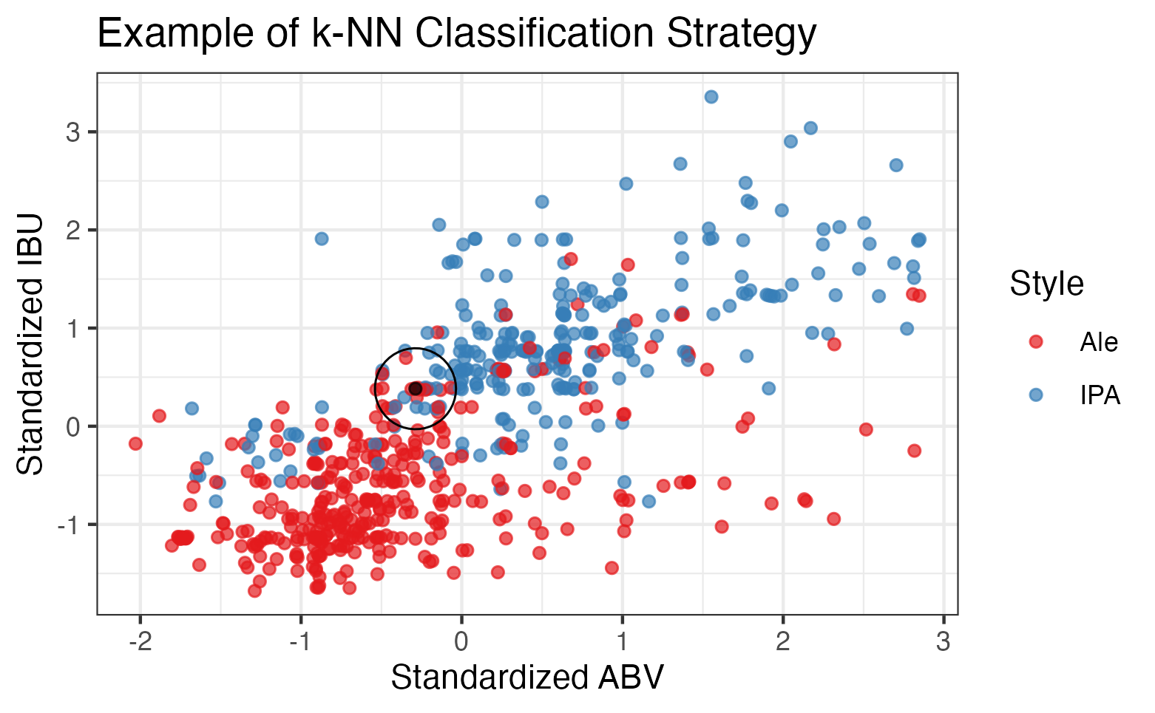
k Nearest Neighbors (k-NN) classification
What it does?
Predicts style from the majority style of beers with similar ABV and IBU values
Three-step approach:
Optimized parameters of model
Evaluated two validation techniques, internal and external
Compared to a different style model, Naïve Bayes
Notes:
To differentiate between beer types, we used a classification method called k Nearest Neighbors (k-NN).
This method employs a majority rule approach, predicting a beer's style based on the most common style among beers with comparable ABV and IBU values.
Here's a visual representation: the style of the unknown black point is determined by the most frequent style within the black circle.
To refine our model, we followed a three-step process: optimizing model parameters, evaluating validation techniques (external and internal), and comparing with another model type, Naïve Bayes.

Slide 9
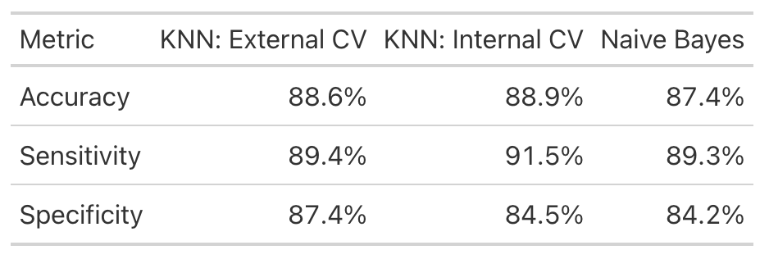
Results from 3 different models:
All models performed well.
k-NN with external validation:
Accurately classified 88.6% of beers
Exceeded random guessing (p-value, < 2e-16)
95% confidence interval (85%, 91%)
Correctly classified 89.4% of Ales and 87.4% of IPAs.
Conclusion:
Evidence suggests the k-NN model can determine IPA or Ale based on ABV and IBU with statistical significance.
Notes:
These are the summarized results.
All models performed well, with k-NN showing slightly superior performance.
The kNN external validation model accurately classified 88.6% of beers—well above random guessing—with a 95% confidence interval of 85% to 91%.
It correctly classified 89.4% of Ales and 87.4% of IPAs.
Thus, there's statistically significant evidence that the k-NN model effectively distinguishes between IPAs and Ales based on ABV and IBU.

Slide 10
Client Question: In what states might the market might have room for expansion? In each of those, what 2 most popular styles countrywide are not being currently produced?
Notes:
Now, let's explore potential market expansion opportunities.
Specifically, which states might offer room for growth, and which two most popular beer styles nationwide are not currently being produced in those states?

Slide 11
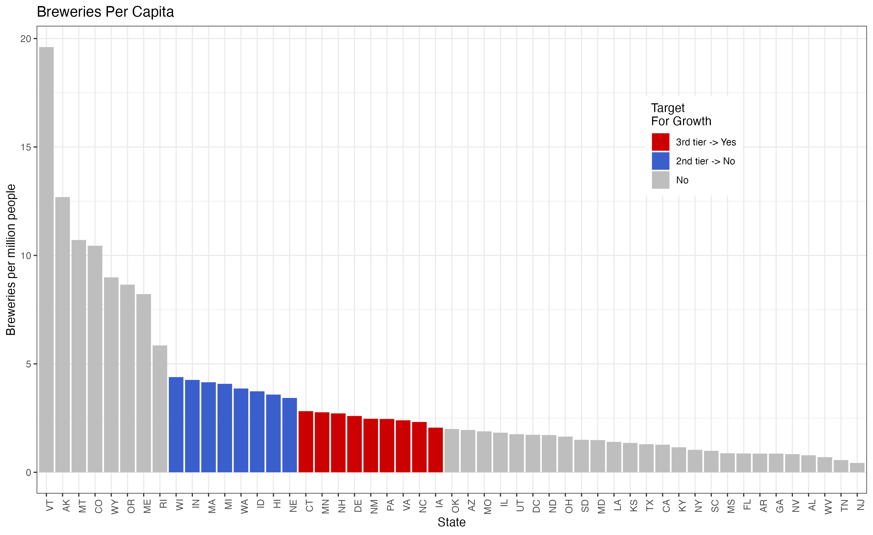
Notes:
To begin, we quantified the number of breweries per capita in each state and identified a second-tier cluster around the 75th percentile shown in blue and a third cluster above the median shown in red.

Slide 12
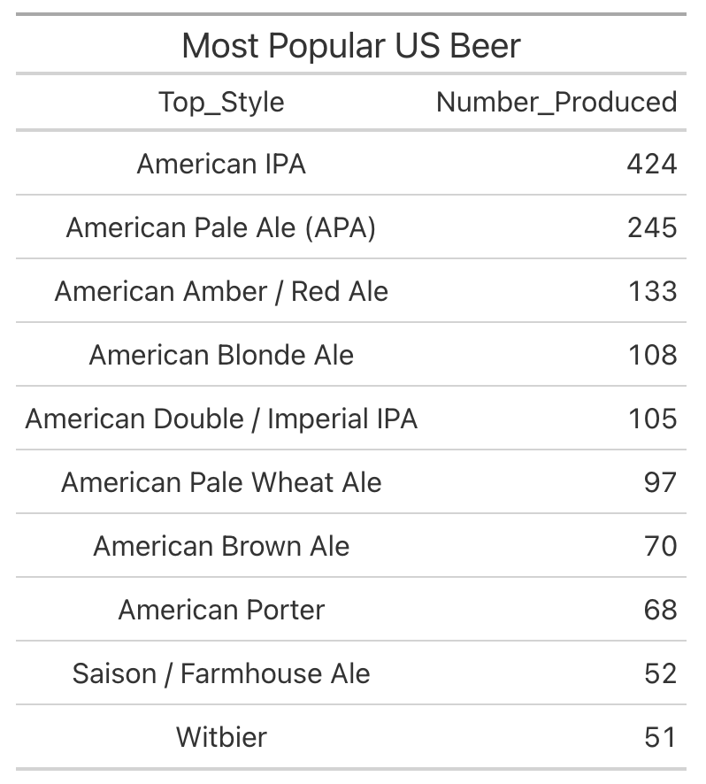
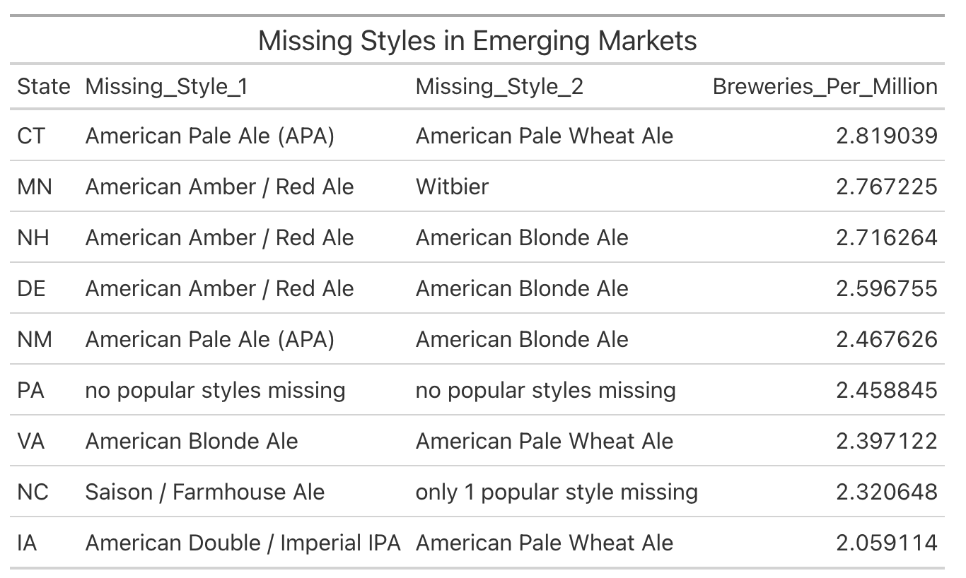
Notes:
We then examined the ten most popular beers in the country, as shown on the left.
Many of these popular beers are already produced in states around the 75th percentile but not in the nine states above the median.
7 out of these 9 states do not currently produce at least 1 of the top 5 most popular beer styles.
Referencing the table on the right, we highlight the most popular beers not currently produced in each state.
Given the absence of popular beer styles in these markets, expanding production to include them and targeting these emerging markets could be worthwhile strategy.

Slide 13
Summary
After imputing values, there was still evidence of a strong correlation between ABV and IBU.
Using k-NN classification, ABV and IBU are good predictors of beer style.
Within several states with emerging craft beer markets, there is an opportunity to introduce popular beer styles that we believe could increase Budweiser's profits.
Notes:
So to summarize,
We found that after imputing values,
Alcohol by volume and international bitterness units

Slide 14
Thank You!
For additional information:
Willis A. Jones
wajones@smu.edu
Kristin Henderson
hendersonk@smu.edu
Notes:
Thank you very much.
If you would like further analysis of these data, please follow up with use.
Here is our contact information.
Thanks and have a great rest of your day.

Slide 15
Link to video presentation
https://www.youtube.com/watch?v=VVhFkVwtyMY

